Slide 1



ITI Graduation Project:
Loan Credit Analysis
We are excited to present our graduation project, focusing on loan credit analysis.
Our team utilized the Lambda Architecture to gain insights from LendingClub loan data, combining historical and real-time processing for comprehensive analytics.

Slide 2


Meet the Team
Belal El-Taiby [Leader]
Fady Elhosary
Haidy Hossam
El-Hussen Ahmed
Adham Hassan

Slide 3



Project Overview
Data Analysis
Comprehensive analysis of LendingClub loan data, including applicant demographics, loan amounts, and interest rates.
Insight Extraction
Identification of key factors influencing loan risk and performance using advanced statistical techniques.
Real-time Processing
Implementation of a Lambda Architecture to process both historical and real-time loan data for timely insights.
We analyzed LendingClub data, focusing on applications, amounts, and rates.
Our project combines historical batch processing with real-time streaming.

Slide 4
Understanding Lambda Architecture
Batch Layer
Speed Layer
Serving Layer
Processes historical data for accuracy.
Provides real-time insights.
Combines batch and speed for queries.
Lambda combines historical data with real-time processing for insights.

Slide 5



Technical Implementation
Batch Processing
Hadoop for large-scale data.
Streaming
Kafka for real-time pipelines.
Serving Layer
Combining batch and streaming.
Our implementation includes Spark for batch processing.
We used Apache Kafka and Spark Streaming for the real-time data pipeline.

Slide 6
🧱Dimensional Modeling
1
Snowflake Schema
2
Fact Table
3
Dimension Tables
A Snowflake Schema optimizes performance and storage in our system.
The Loans fact table is central to our data model.
We included Borrower, Date, and Loan Product dimension tables.

Slide 7
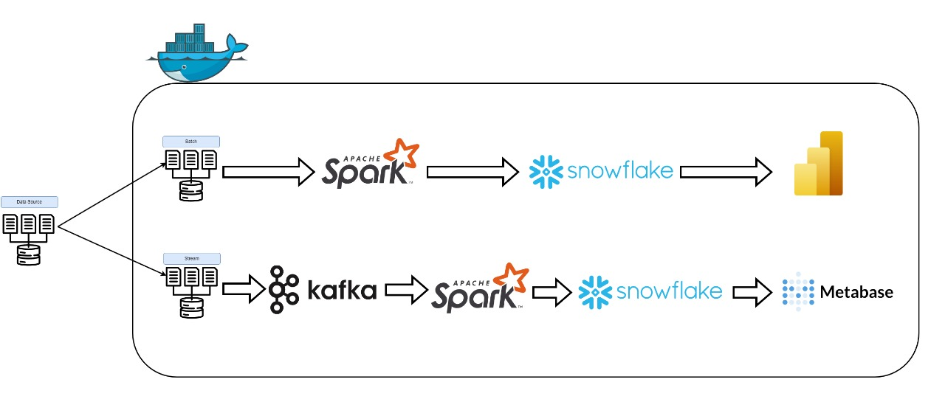
🛠️ Tools & Technologies
1
Snowflake
Cloud data warehouse for scalable data storage and analytics.
Apache Spark
Used for batch ETL to transform and load data efficiently.
Apache Kafka
Real-time data ingestion via publish-subscribe messaging.
Power BI & Metabase
Data visualization for batch and streaming data insights.

Slide 8



🗂️ Batch Processing Steps
Read CSVs using Spark
Utilize Spark's capabilities to efficiently read CSV data.
Transformations and Cleansing
Apply necessary transformations and cleanse data.
Load into Snowflake
Load the transformed data into Snowflake for storage.

Slide 9



⚡ Streaming Processing Steps
Simulate Data
Kafka streams emulate real-time loan data.
Process Data
Spark Streaming processes incoming loan data.
Ingest to Snowflake
Data loads into Snowflake in near real-time.

Slide 10
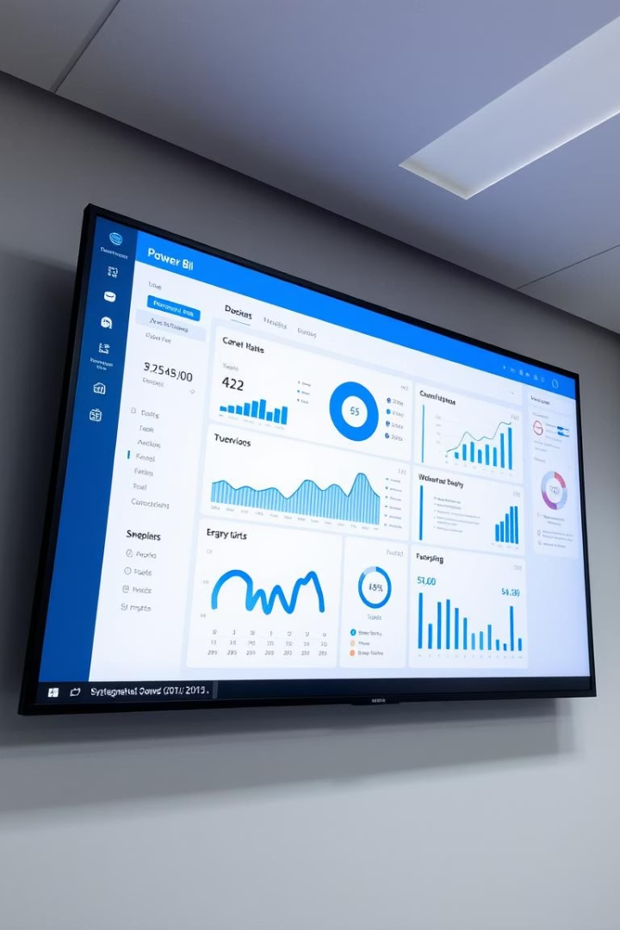


Data Visualization
Interactive dashboards in Power BI and Metabase provide real-time insights.
Power BI
Metabase
Dashboards for batch processing insights.
Visualizations for streaming data monitoring.

Slide 11
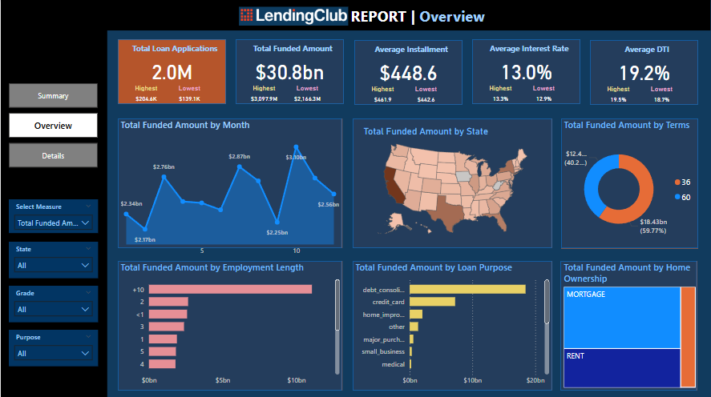
Power BI dashboard for batch data
Power BI provides insights into Batch loan data.
1
Real-Time Insights
Track loan statuses and key metrics
2
Customizable Dashboards
Tailor dashboards to specific monitoring needs.

Slide 12
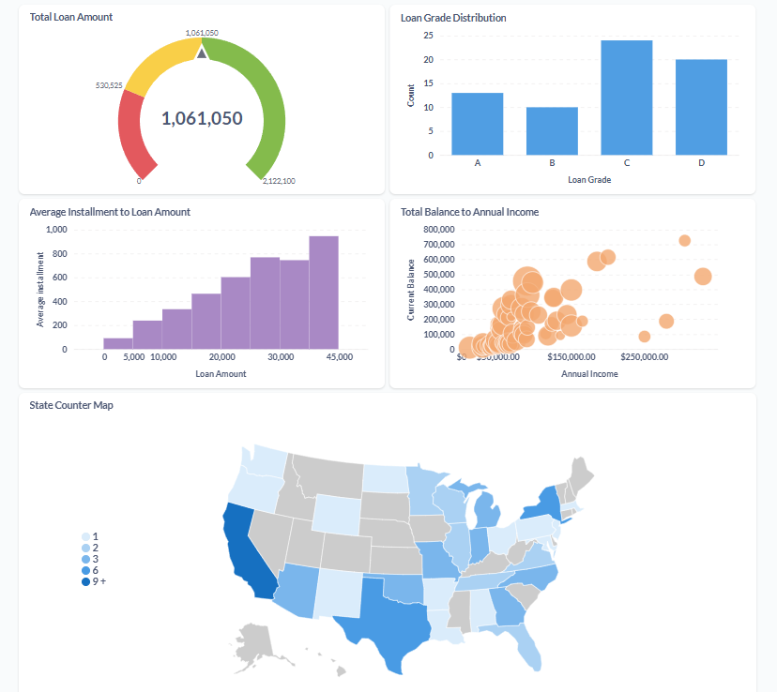



Visualizing Streaming Data with Metabase
Real-time insights are crucial for monitoring loan performance.
Real-Time Monitoring
Track loan statuses, approvals, and risk factors.
Interactive Analysis
Explore data to identify trends and anomalies.
Customizable Views
Create specific visualizations using filtering capabilities.

